Slide 1
An Introduction to Web Application Security
Class 1: Introduction to AppSec
December 15th 2014
Daniel Somerfield
Lead Consulting Developer
ThoughtWorks
Notes:
Been in the AppSec business on and off since 1997 or so
Co-founder of ISNetworks
Developed digital signature and encryption solutions for, among other companies, a certificate authority
Previous companies
Developer for compliance and monitoring software
Vulnerability intake and mitigation
Training front and back end developers how to do secure coding
Current a lead software developer at ThoughtWorks in SF.
So basically, I’m a dev who thinks security matters – what that means is that I come at these issues from an engineering perspective. But I am, and always have been a big picture thinker, so issues of process are always on my mind.
I’m a fan of Socratic-style presentation which is challenging in this model, so I will ask you to provide feedback via the online chat. I won’t be able to react right away because I will be talking at you.
Question: Who are you? Answer in the chat and that will allow me to tweak the focus of my discussion.
What do you identify as:
Manager?
Developer?
QA?
Project Manager?
Product Owner
Executive?
Something else?
If you write code: what languages and do you consider yourself novice / intermediate / expert?
Why are you taking this class?
Pure intellectual interest?
Improve your qualifications for career advancement purposes?
Do you want to learn how to set up an appsec program in your company?
Other reasons?

Slide 2
This Week’s Agenda
December 15th: Introduction to AppSec
December 16th: Injection
December 17th: Vulnerable Authentication & Session Management
December 18th: Cross-Site Scripting
December 19th: Secure Development Process
Notes:
Introduction to AppSec
Key concepts and approaches
Three days of secure coding and architecture
Final day on how this fits into your organization
I won’t be providing much in the way of code examples. Flow will largely be a in pseudo-code. This is for the following reasons:
I don’t know how many of you are coders and how many are more manager, PMs, etc
I don’t want to be particularly language-specific.
The nature of this style of presentation means that not much is possible in the way of live demoing.
Examples will be available in github
If you can tell me what languages you work in, I might be able to provide you with some example code in your platform of choice, assuming I know it or can find it.
The principals are more or less then same, regardless of platform
What I will address
Security concerns for front end, backend, and full stack developers
How security influences application structure and architecture
How security concerns influence process and practice
What I will not address
Securing Operating Systems
SSL Configuration
The details of encryption algorithms or protocols
Network topology
Pen-testing and Tooling
Because:
They are not my area of specialization
I a code and there is more than enough material to fill a session with strict coding focus

Slide 3
Why is AppSec Important?
J.P. Morgan
P.F Chang’s
Home Depot
Dairy Queen
MBIA
Jimmy John’s
Goodwill
…
Notes:
Let’s starting by talking about why appsec is important. I imagine believe it is or you wouldn’t be here.
This is probably not the first time you have seen a list or one much like it. Major breaches like this are driving industries to pay more attention to their security postures. Nobody wants to be the next “compromised-major-company-of-the-week”.
These breaches are forcing companies to rethink:
Operational IT
Data retention policy
Network security
To be clear: some of these breaches were operational security lapses. That’s the real challenge here. There are so many ways to get this wrong. Just because you DO secure coding doesn’t mean you don’t need to also worry about operational security. Issues of network security and governance matter. They’re just not all that matters, although they have been thought of that way.

Slide 4
Why is this difficult?
Complexity of software requirements
Speed of technology evolution
Lack of focus and understanding in product organizations
Challenges in cost / benefit analysis
Technologies that simply were not designed with security in mind
Notes:
I won’t lie: in all this time I have probably created my fair share of vulnerable software. Most of us have.
And I have to be honest about the state of the industry:
It ain’t great.
There are a lot of best practices but very few are proven.
The research is spotty at best as far as what works and what doesn’t work.
AppSec practices are new and we are still feeling our way
I am going to assume for a second that you largely agree that this *is* difficult. If you disagree, you are welcome to do so on the message board and we can fight it out later.
But, from what I am seeing, compared to operational security, focus on application security has been lacking, particular when it comes to the “builder” side of the equation. We’ll talk more about what that means shortly.
When I started in this business, hackers were college students and hobbyists. Now they are members of organized crime syndicates, foreign governments, and not-so-foreign governments.
Hackers have all the time in the world to break in. You have very little time to react. Hackers just need one hole. You need to patch everything.
I suggest it is difficult for the following reasons:
Complexity of software requirements
Today’s software is vastly more complicated than anything ever conceived by the human mind and the discipline is fairly new
How long did it take to create a safe that can’t be cracked. Well, if Hollywood action movie plots are right, they are still working on it
Speed of technological evolution
Hard to create a good practice when the underlying technology and requirements is unstable
How long has Angular been around?
Lack of focus and understanding in product organizations
The “security” checkbox – all these requirements… plus make it secure
Challenges in cost / benefit analysis
This stuff isn’t easy to measure and frankly, we are bad at it
Technologies that simply were not designed with security in mind
This is the big one
Examples:
No true separation between code and content
HTTP is a stateless protocol with state layered on top
SSL / TLS still isn’t the norm because of performance or at least the perception of it as an issue
Key management
Everything comes down to context

Slide 5
Aspects of Application Security
Operational Security
  e.g. Firewall Configuration
  e.g. Network partitioning
  e.g. Password management
  e.g. Key management
Notes:
If we all agree that this is important. Extremely important. Maybe even the MOST important aspect of application development, what then?
As I mentioned, there are a series of concerns. In this class we are going to focus on the engineering concerns. Within engineering there are multiple interested parties, but we are going to focus primarily on the concerns of developers themselves, and to a lessor degree Quality Assurance? Although this will be at least somewhat technical, the issues are EXTREMELY relevant to product owners, project managers, scrum masters, etc because it is in your best interest and the interest of your organization to understand these issues when they arise, how to triage them, and what are the risks of ignoring or deprioritizing them.
You can build a fairly complicated taxonomy of Information Security concerns, but I will try and keep it simple for the sake of this session:
We will not spend much time on operational security, network security but rather focus on what people who are directly involved in the development process need to be aware of. Mostly I will be focus on secure engineering practice and processes although I will touch on issues relevant first order so-called “functional” concerns like password storage.
TODO: this is redundant—do I need it earlier???
Operational security:
preventing people from outside from getting in
preventing people from inside from getting more than they should

Slide 6
Aspects of Application Security
Security Policy & Governance
  e.g. Data retention
  e.g. Password expiration
  e.g. Encryption standards
Notes:
There is some overlap, particular on that third item.

Slide 7
Aspects of Application Security
Engineering Practice and Process
  e.g. Secure coding
  e.g. Functional security concerns
  e.g. AppSec automation
Notes:
SIDEBAR:
There is a tendency in the AppSec community to say “the sky is falling”. Incidentally, “the sky IS falling” but as a engineer, I can run around screaming and pointing up in the air, or I can build something to prevent the debris from hitting me in the head. I prefer the latter approach.
There is no such thing as “perfect” security in a useful application
AppSec is not only a development process but a risk management process
We are not very good at measuring it at this point and so that risk management process is tricky

Slide 8
Aspects of Application Security
Quality Assurance / Management
  e.g. AppSec automation
  e.g. Penetration testing
  e.g. TODO: another item?
Notes:
I know I have AppSec automation in here twice, but I think it’s appropriate because in a contemporary TDD process engineers are going to be responsible for automation, while in a more partitioned environment that could fall to QA / QM testers and SDETs.
SIDEBAR:
There is a tendency in the AppSec community to say “the sky is falling”. Incidentally, “the sky IS falling” but as a engineer, I can run around screaming and pointing up in the air, or I can build something to prevent the debris from hitting me in the head. I prefer the latter approach.
There is no such thing as “perfect” security in a useful application
AppSec is not only a development process but a risk management process
We are not very good at measuring it at this point and so that risk management process is tricky

Slide 9
Aspects of Application Security
Product Requirements / Intake
  e.g. Security requirements creation
  e.g. Risk Management
Notes:
Although this won’t be the focus of our week, this is an big one. Product owners have to care about this and understand the risks and trade-offs.

Slide 10
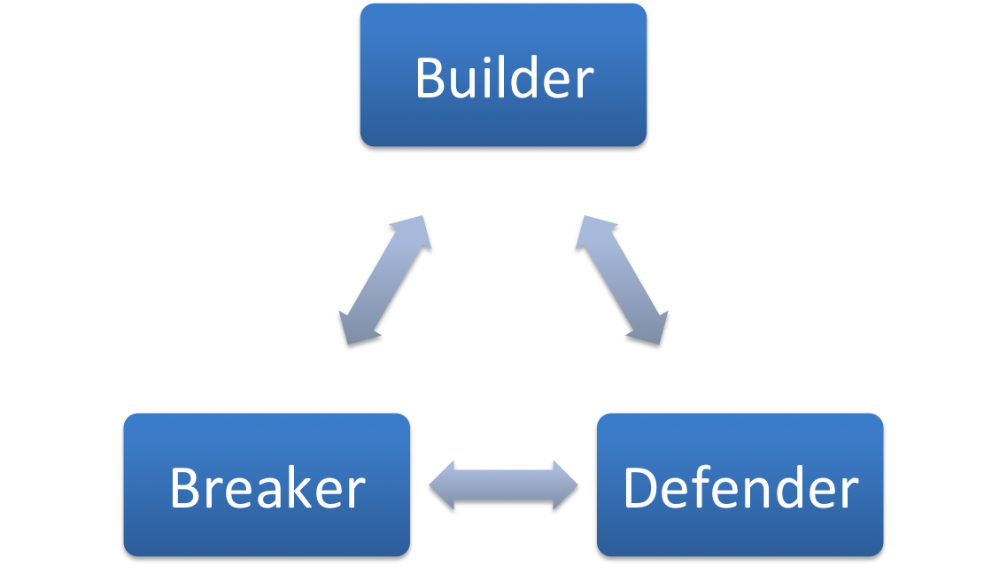
The AppSec Roles
Notes:
A quick note on terminology. The AppSec engineer process is generally thought to have three main components, although in some ways from a personnel perspective, this can be somewhat artificial.
Builders: people developing code that provides security or mitigation for vulnerabilities – traditional what we would think of as development or engineering
Breakers: people validating that code is secure via tools-driven or manual testing (Penetration or Pen testing). Often falls into the area of Quality Assurance.
Defenders: people who use tooling and configuration as a mechanism to mitigate vulnerabilities, either temporarily until the actual application is fixed, or even permanently if it is not going to be

Slide 11
The Principals
Trusted & Untrusted Data
Defense in Depth
Positive Modeling
Least Privilege
Notes:
Trusted & Untrusted Data
My Dad drives a motorcyle—Dad is not the most risk-tolerant person I know. At some point I asked him how someone so risk-averse could drive a bike and he said, “when I drive a car, I assume everyone is an idiot. When I drive a motorcycle, I assume everyone is out to kill me.”
If you learn only one thing from this entire session, then it should be this idea. The user is an attacker. Anything coming from outside a boundary you control should be assumed to be hostile.
This is a scale and varies enormously based on your domain. The level of trust you give to an anonymous user on the Internet should be different than data coming from another application behind your firewall. But even in the latter case, that trust should not be absolute.
Defense in Depth
Don’t assume someone else will protect you.
Example of mod-security:
A company I cannot name was using mod-security as their primary defense against SQL injection, XSS attacks, etc. The site was scaling up and operationally, mod sec was no well maintained or upgraded. As a result it cased performance issues. One day an operational team turned in off, without telling the security team and without telling the engineering teams. As you might imagine, pen testers starting finding vulnerabilities that hadn’t been there. Application engineers had been assuming that mod-sec would protect them, although it wasn’t part of their development process and even though they were not making any assertions that was the case in the development pipeline.
Positive Modeling
White-listing
Positive modeling process
I’m breaking my own advice a bit here and talking about exploits rather than best practices over the next couple of days, largely because more than anything else an intro course like this needs to convey how critical all this is and talking about exploits is a good way to do that.
Least Privilege
Never grant any more permission than you need
Has an aspect of positive modeling: start from the most restrictive permission set and open up, don’t start open and lock down.
java.security.AllPermissions is a horrible idea

Slide 12
Development Process & Practice
Code Review
Education
Threat Modeling
Auditing / Logging
Notes:
So how do we apply these principals or convey them to our engineers and QA? How do we make sure that our functional security concerns are addressed as well as making sure we are practice secure coding. I can tell you most likely most of your coders don’t think much about these issues and your product owners and project managers think about them even less.
Much of this is based on convention wisdom. There is not an enormous amount of extant research about the effectiveness of various approaches to preventing vulnerabilities from being introduced during development.
OWASP strongly advocates for a code review process for example: “Code review is an excellent source of metrics that can be used to improve your software development process” – but they don’t quantify what “excellent” means.
Here is my unscientific recommendations:
Education is likely a good investment, especially, low cost investment like lunch & learns. Get motivated members of the team to present ideas to the team.
Threat modeling: I believe it’s a useful mechanism for getting people thinking in the right terms, but again, I have not yet seen research suggesting how effective it is.
Logging: having a good record of what happened, by whom and when is a no-brainer BUT, it is only worth the investment if you are willing to make it somebody’s responsibility to audit the results.

Slide 13
Testing Process & Practice
Pen Testing
  Manual
  Tools-based
Automation
  Unit testing
  Functional testing
Code Analysis
  Static
  Dynamic
Notes:
Common methodologies on the QA side
Penetration testing is the “breaker” process
Pen Testing
Manual: individual attempts to find exploits by hand. The advantage is that you know the app.
Tools
Fuzzers
Scanners
Automation
No different than any other assertion. Mis-use cases can be automated.
Code analysis
Static analysis tools
Data flow analysis tools

Slide 14
Organizational Process & Practice
SDLC Considerations
Maturity models
Response Planning
Organizational Responsibility & Delegation
Notes:
SDLC
When do you think about security? Is a scan run at the end of the process when it is too late?
Water-fall vs agile:
I believe there are pluses and minuses of each. Waterfall creates more obvious ways of adding security concerns into the structure but they run the risk of becoming “compliance” rather than security.
The mantra of the agile community that you should only build things that the customer wants creates some tension here, however a true continuous delivery environment makes pushing a patch much easier.
“Internalize” the security “externalities”.
Maturity models: BSIMM, OpenSAMM
Evaluating and improving your organizations security practices
Response planning
What do you do when you have a security incident?
Organizational responsibility
We can have best practices all day, but if no-one is on the hook, things will be missed

Slide 15
AppSec Anti-patterns
Security Checkbox
Compliance as Security
Roll-your-own encryption and protocols
Security through obscurity / complexity
Notes:
Admittedly, this is a little bit of a hodgepodge—a mix of processes, but in my view all valid.
Security Checkbox (process)
Security should not be something you just DO. In other words, when negotiating with business interests, you will hear: implement feature X and yes I want security with that. It’s like someone saying “fries with that.” Doesn’t work that way. It’s a way of avoiding the responsibility of avoiding understanding the issue.
Compliance as Security (process)
Don’t think you’re secure because you are SOX or PCI compliant. Compliance is NOT security.
Security through obscurity / complexity (technical)
I have gotten into arguments with engineers who wanted to encrypt a key for transmission on an iPhone. What do you encrypt the key with? What do you encrypt that key with….” They argued that “it can’t hurt”. It can. Adding technical debt with no payoff is not only a poor engineering decision in a general decision, but it adds more things to fail. Complexity and security are often at odds.
Roll-your-own encryption and protocols (technical)
Just don’t. Armies of highly trained cryptographers admit every few years that the encryption flavor of the week has been cracked. Don’t think you can do a better job than these highly specialized mathematicians.
Similarly, protocols are tricky. Unless you are doing something unprecedented (and you’re not), there is an existing, understood (proven?) protocol for you. Don’t think because you roll your own, you are less likely to be hacked.

Slide 16

References

Slide 17
This Week’s Agenda
December 15th: Introduction to AppSec
December 16th: Injection
December 17th: Vulnerable Authentication & Session Management
December 18th: Cross-Site Scripting
December 19th: Secure Development Process
Notes:
SQL Injection
OS Command Injection
Brief mention of other kinds of injection

